Slide 1

ATLIQ HARDWARE
SQL DATA ANALYSIS PROJECT
-Sanskruti Palekar

Slide 2
Introduction
Problem Statement
Welcome to Atliq Hardware.
Atliq Hardware is a leading hardware company spread across the globe and transports computer peripherals as keyboards, mice, printers etc.
Despite Atliq Hardware's exceptional performance in previous years, the management identified a gap in revenue and sales.
This was the time when they realised the need of insights from their data to come up with strategic moves to boost sales and understand market sales, segment variations to make company aligned decisions.
The goal is to assess the company's performance in 2021 compared to its sales in 2020.
For this project, my task involves utilizing a dataset to address 10 distinct ad-hoc requests through SQL queries.

Slide 3
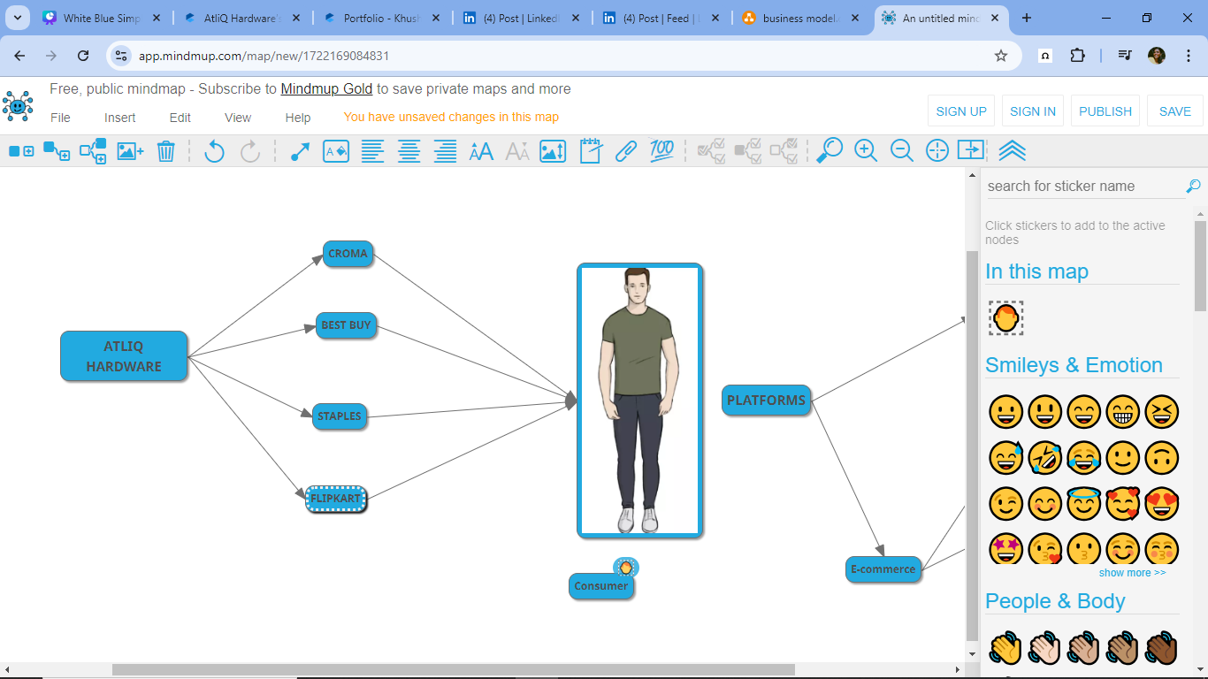
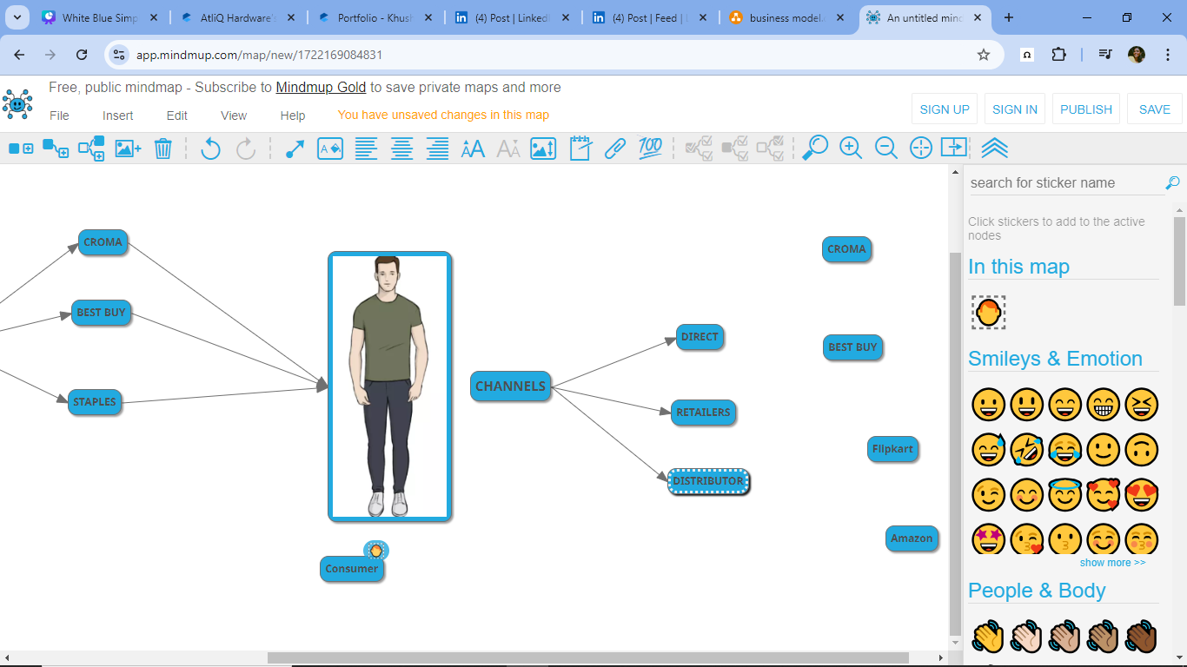
BUSINESS MODEL
CUSTOMERS
CONSUMERS
CHANNELS

Slide 4
Division
PC
N&S
P&A
Segment
storage
notebook
Accessories
desktop
peripherals
networks

Slide 5
Dataset
Dim_customer
Dim_product
fact_pre_invoice_deduction
DATABASE GDBOO41 -->TABLES
Fact_gross_price
fact_sales_monthly
fact_manufacturing_cost

Slide 6
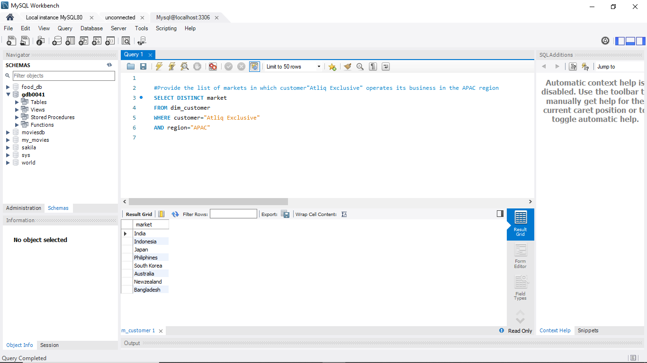
AD-HOC Request-1
1. Provide the list of markets in which customer"Atliq Exclusive" operates its business in the APAC region

Slide 7
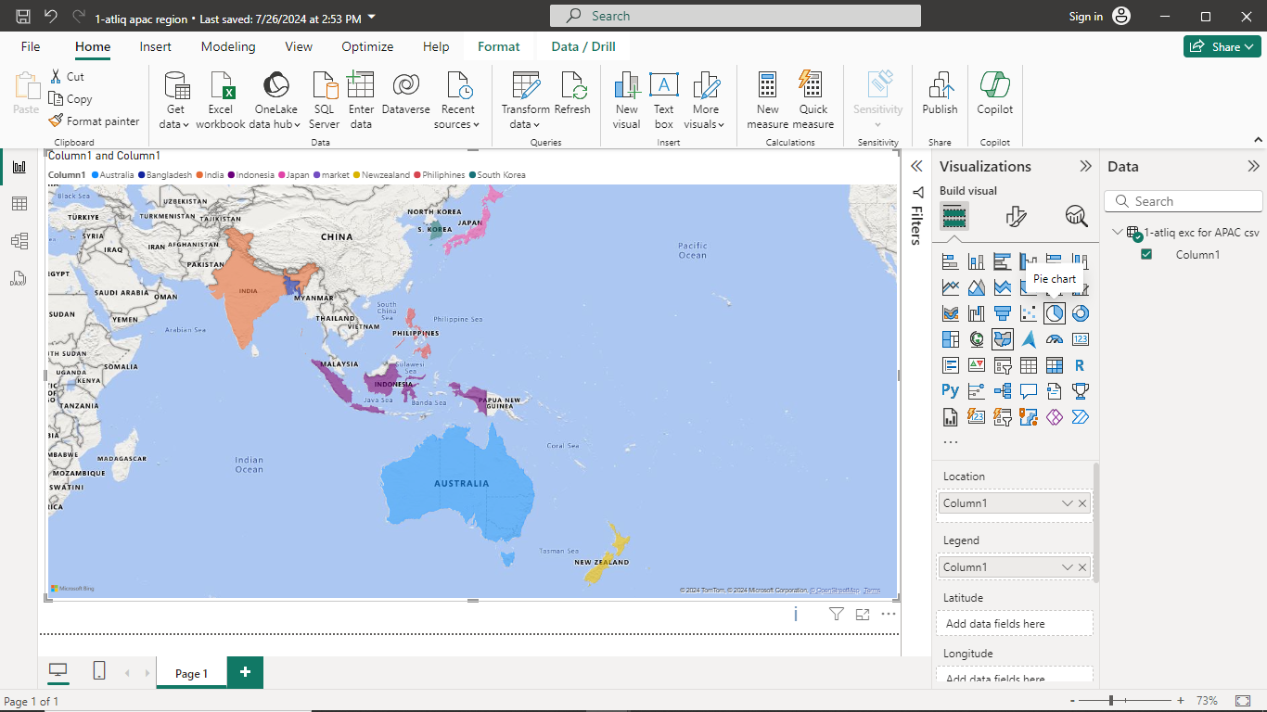
Visuals - 1
Insights
Atliq Exclusive has a strong presence in various Asia Pacific regions including India, Indonesia, Japan, the Philippines, South Korea, Australia, New Zealand, and Bangladesh.
This demonstrates a solid market presence and ability to adapt to diverse cultural and economic landscapes in the APAC regions.

Slide 8
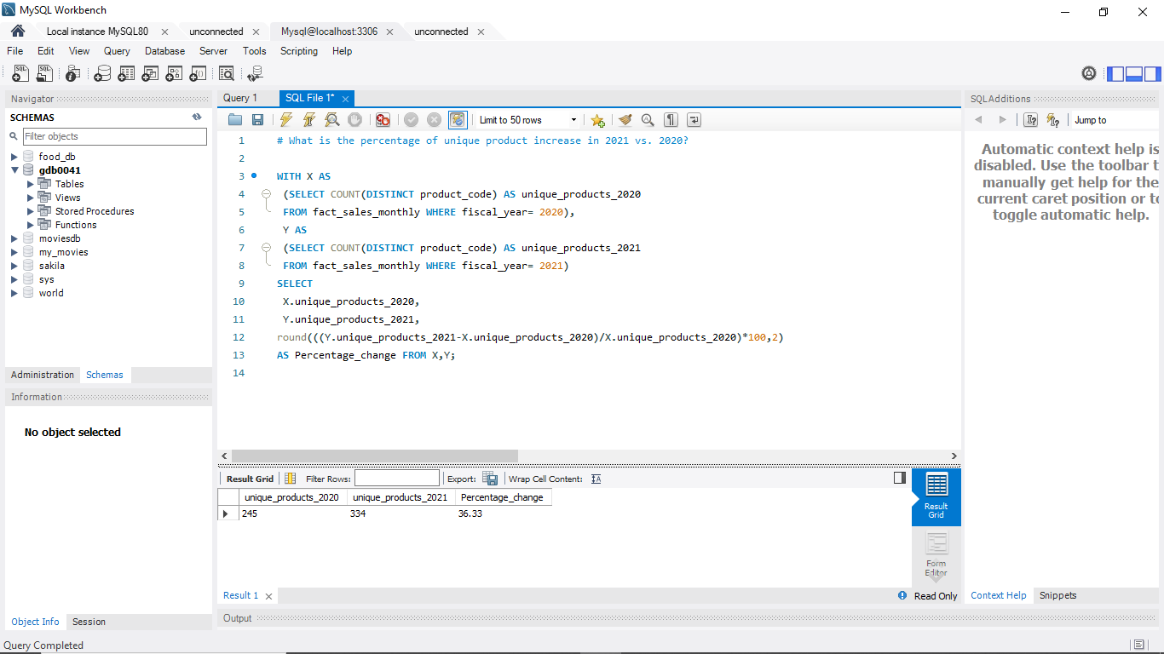
AD-HOC Request-2
What is the percentage of unique product increase in 2021 vs. 2020?
NOTE
Fiscal Year 2020 is from Sep 2019 to Aug 2020.
Fiscal Year 2021 is from Sep 2020 to Aug 2021.

Slide 9
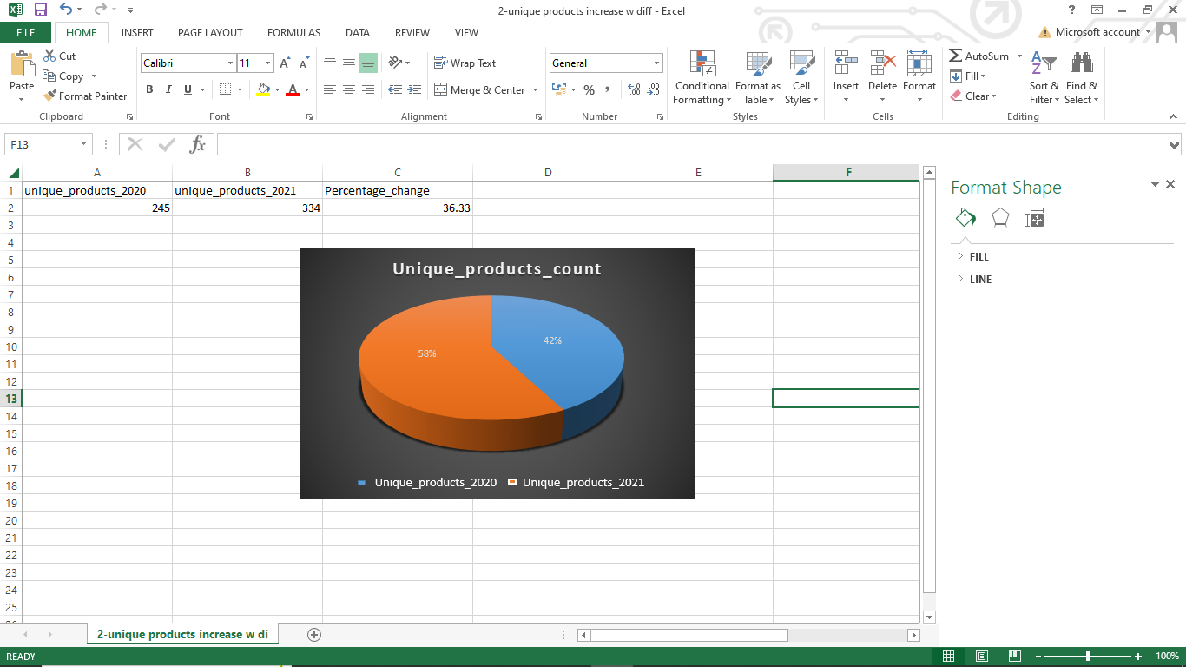
Visuals - 2
Insights
In 2021, Atliq Hardwares experienced a notable rise in product variety, with 334 unique products compared to 245 in 2020.
This reflects a 36.33% increase in unique products over the course of a year.
This increase in product suggests on expanding product offerings, marketing to gain more customer base and build value to gain more profit.
It is a positive indicator of business growth and flexibility in response to evolving market needs.

Slide 10
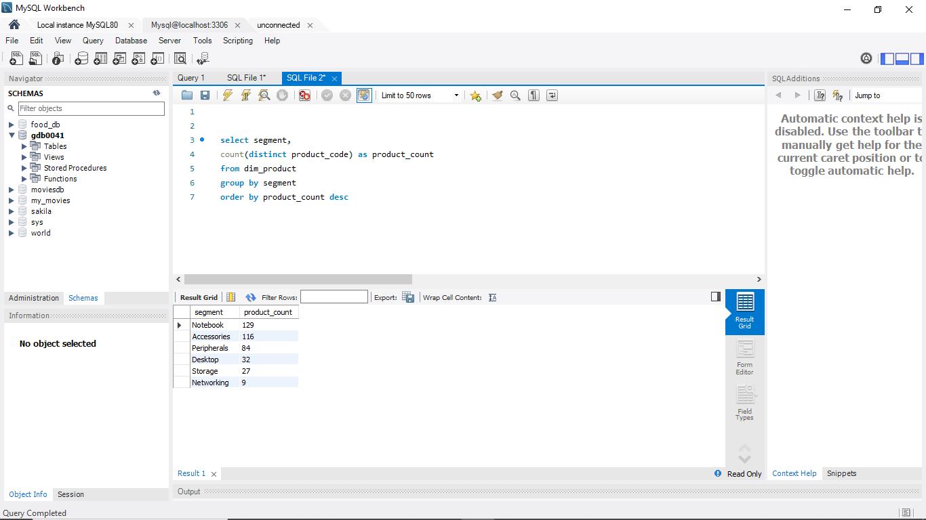
AD-HOC Request-3
Provide a report with all the unique product counts for each segment and sort them in descending order of product counts.

Slide 11
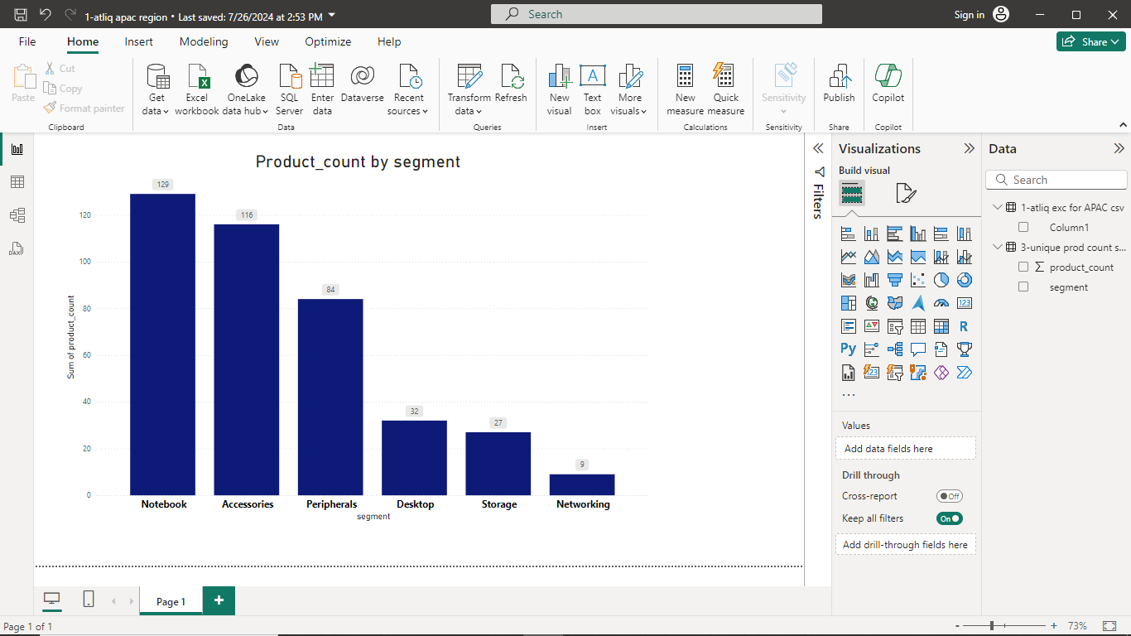
Insights
Visuals -3
At Atliq Hardware, there are a total of six segments.
"Notebooks" rank the highest with a product count of 128.
Conversely, "Networking" has the lowest count of products at 9.
These figures illustrate the product variety within each segment, highlighting that "Notebooks" and "Accessories" offer a wide range and significantly contribute to the revenue compared to other segments.
This analysis aids in identifying scalable product categories and segments that require further attention.

Slide 12
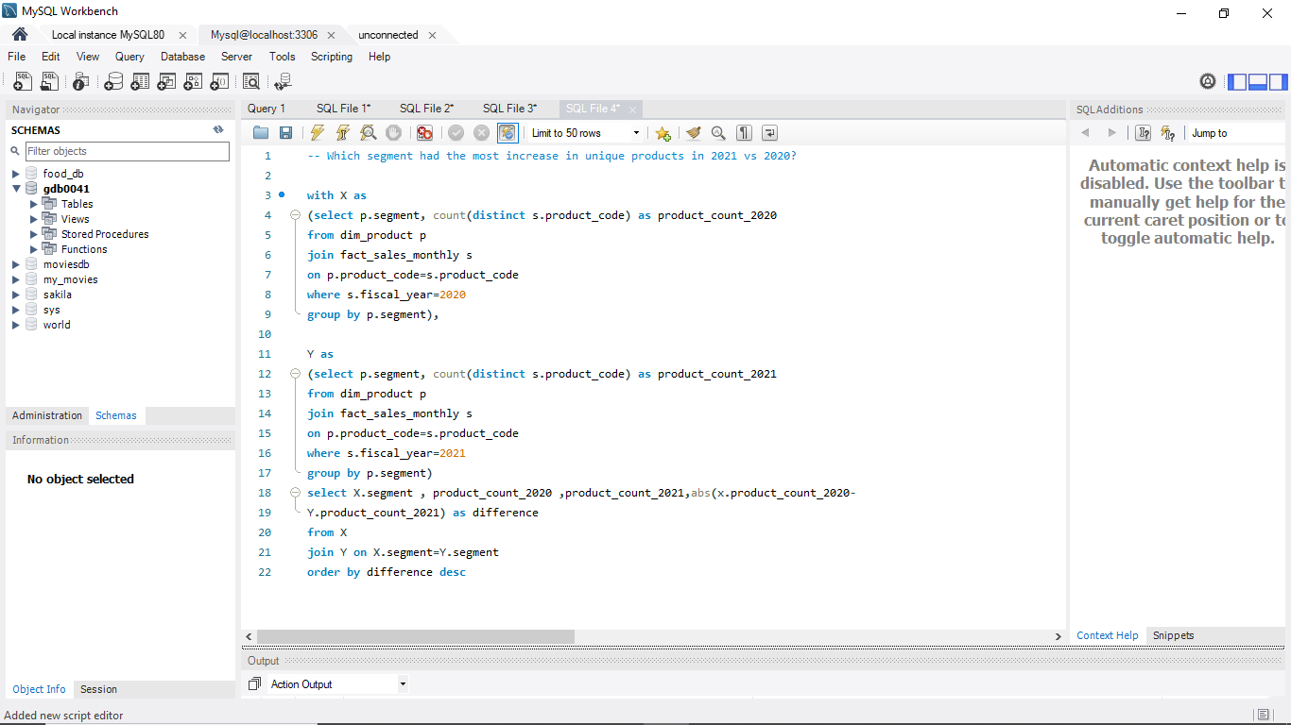
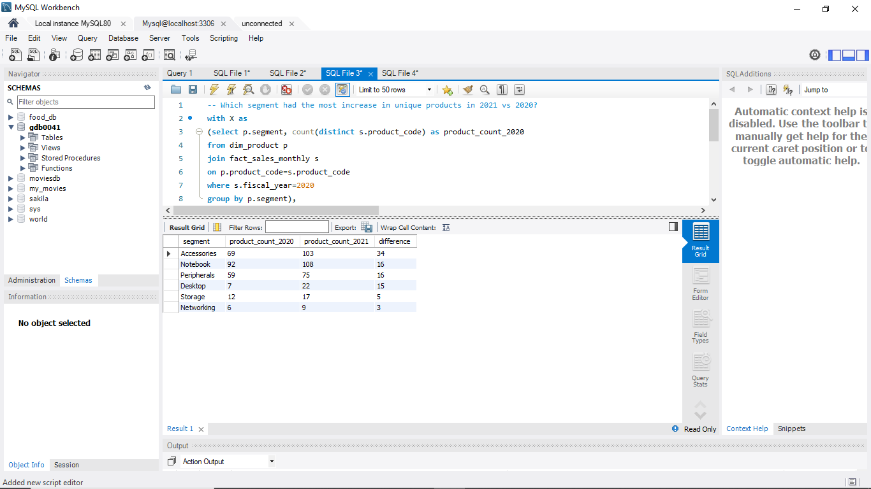
AD-HOC Request-4
Which segment had the most increase in unique products in 2021 vs 2020?

Slide 13
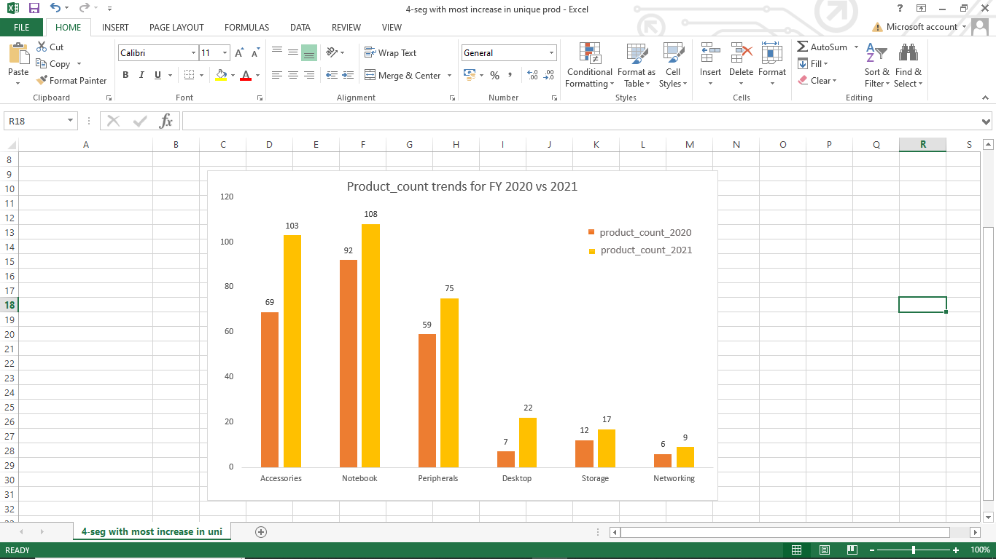
Visuals - 4
Insights
In 2020, "Accessories" fell behind "Networks," but in 2021, it claimed the top spot with 34 more products, indicating efforts to expand the selection.
These insights suggest a growth in products especially in “Accessories and "Notebooks" segments.
These numbers demonstrate the diversity of products in each category.
Diversity can help customers with more choices and boost sales.

Slide 14
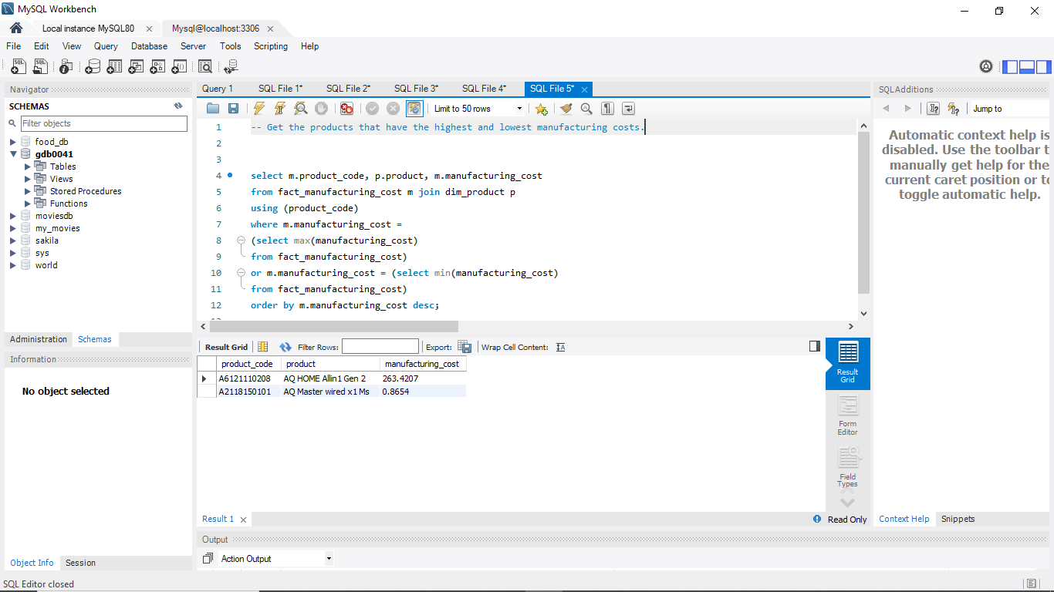
Insights
AD-HOC Request-5
AQ HOME ALLIN 1 Gen 2 has the highest manufacturing cost.
Whereas AQ Master wired x1 Ms has lowest manufacturing cost.
-- Get the products that have the highest and lowest manufacturing costs.

Slide 15
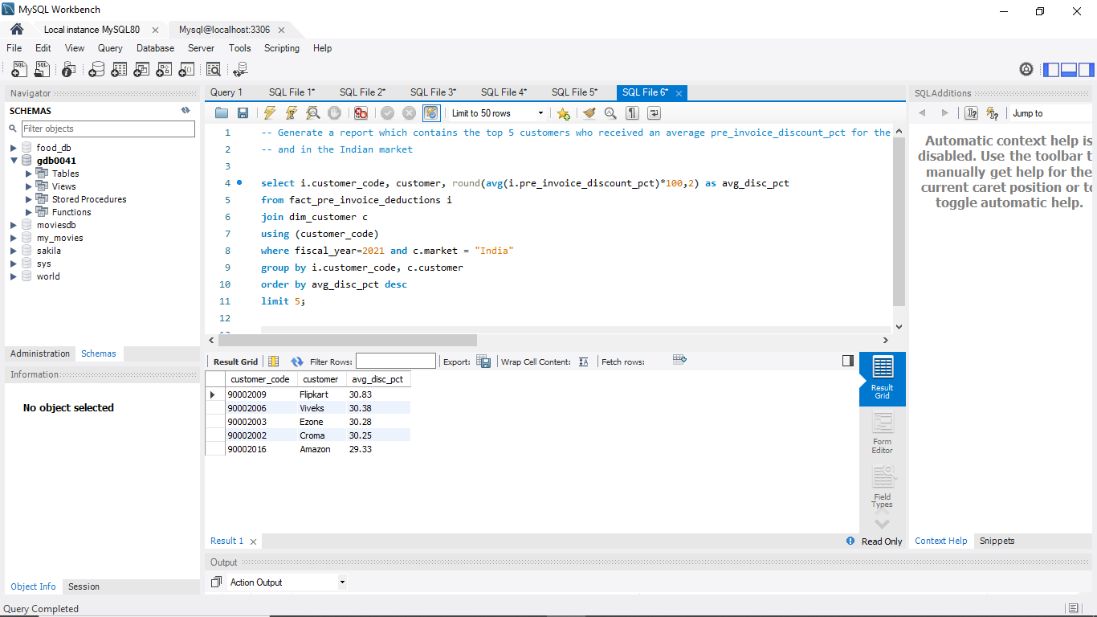
AD-HOC Request-6
Generate a report which contains the top 5 customers who received an average pre_invoice_discount_pct for the fiscal year 2021 and in the Indian market

Slide 16
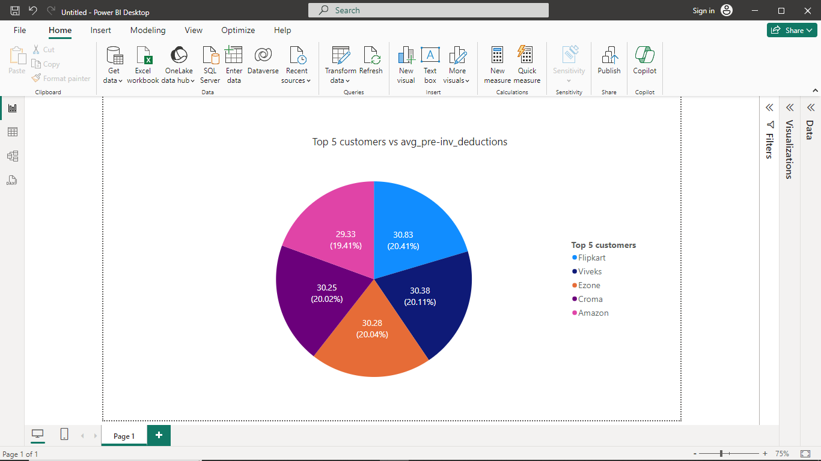
Insights
Visuals - 6
"Flipkart" provides the highest average pre-invoice deduction discount at 30.83%, aiming to offer significant discounts to its customers.
On the other hand, "Amazon" offers a slightly lower average pre-invoice deduction discount of 29.33%.
These findings highlight distinct discount strategies employed by "Flipkart" and "Amazon," with "Flipkart" and "Vivek" standing out as top discount providers.
The comparison also indicates that "Amazon" adopts diverse pricing and discount tactics to attract customers.
These observations can be valuable for understanding customer preferences and experimenting with discount strategies.

Slide 17
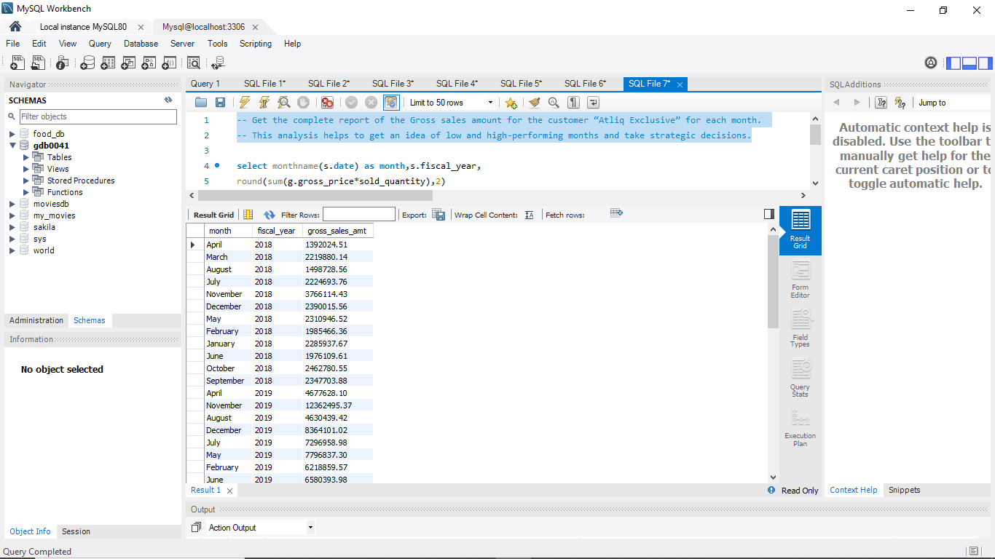
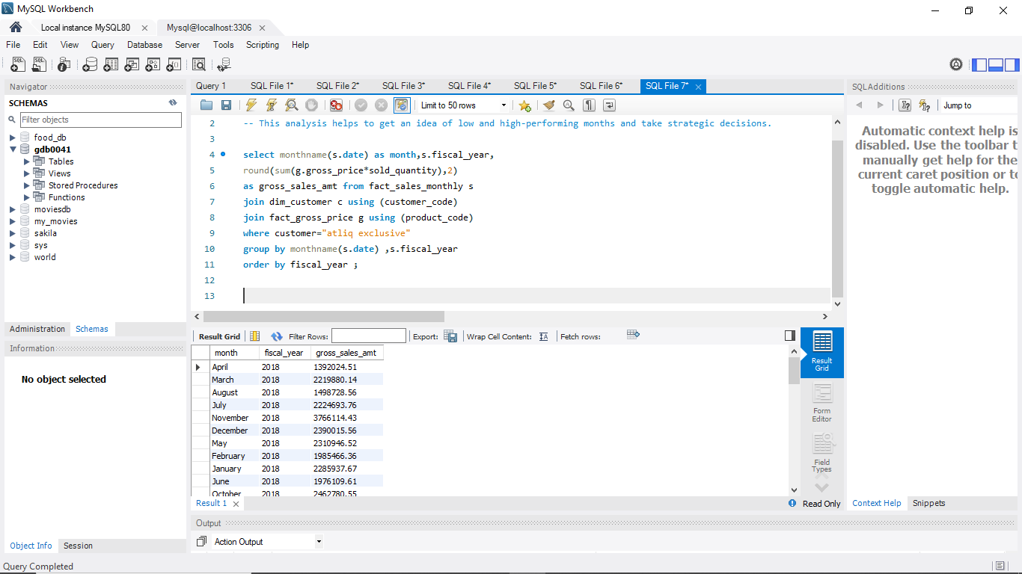
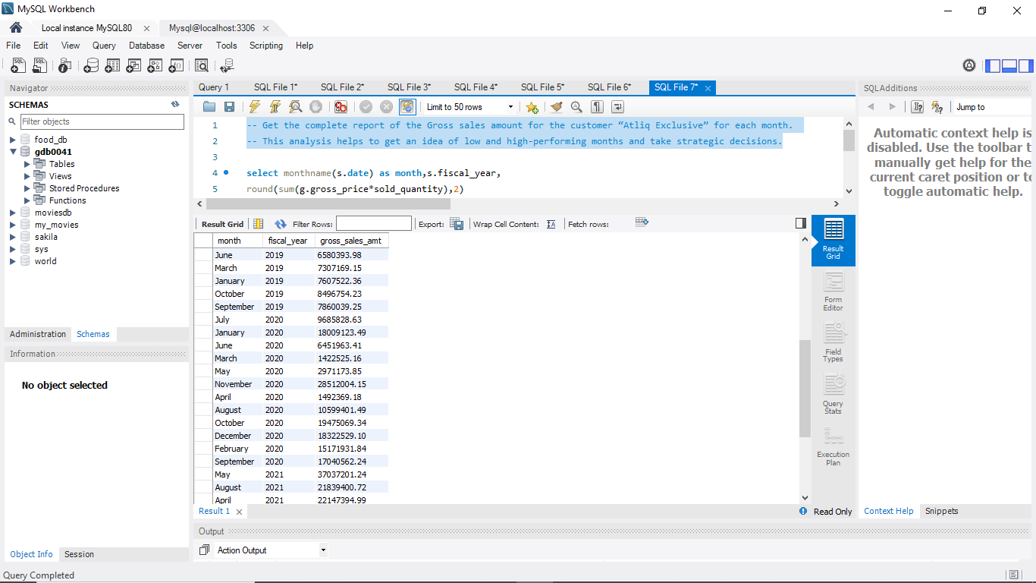
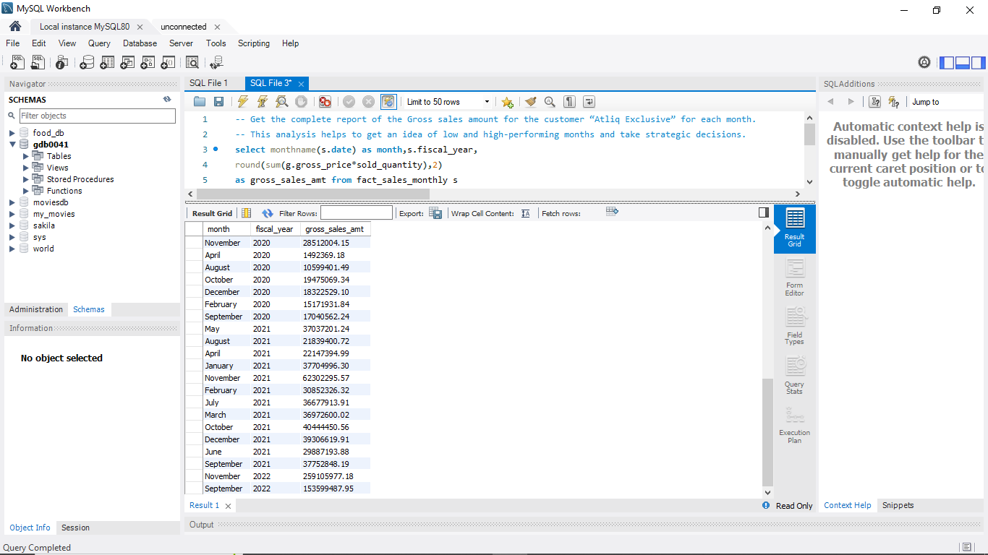
AD-HOC Request-7
-- Get the complete report of the Gross sales amount for the customer “Atliq Exclusive” for each month.

Slide 18
Insights
November 2021 had the highest gross sales amount of $62,302,295.30.
Whereas the fiscal year 2021 started with lower sales.
The months of March and April had lower sales in fiscal year 2020 which comparatively improved in fiscal year 2021 showing strong improved performance .
These insights can help in better understanding peak performing months and apply different strategies on low performing months and improve profitability.

Slide 19
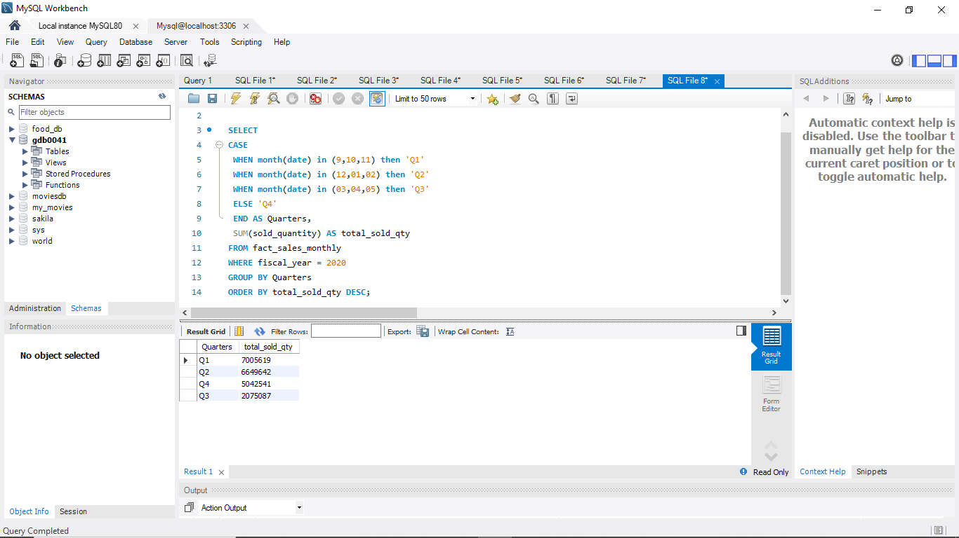
AD-HOC Request-8
In which quarter of 2020, got the maximum total_sold_quantity?

Slide 20
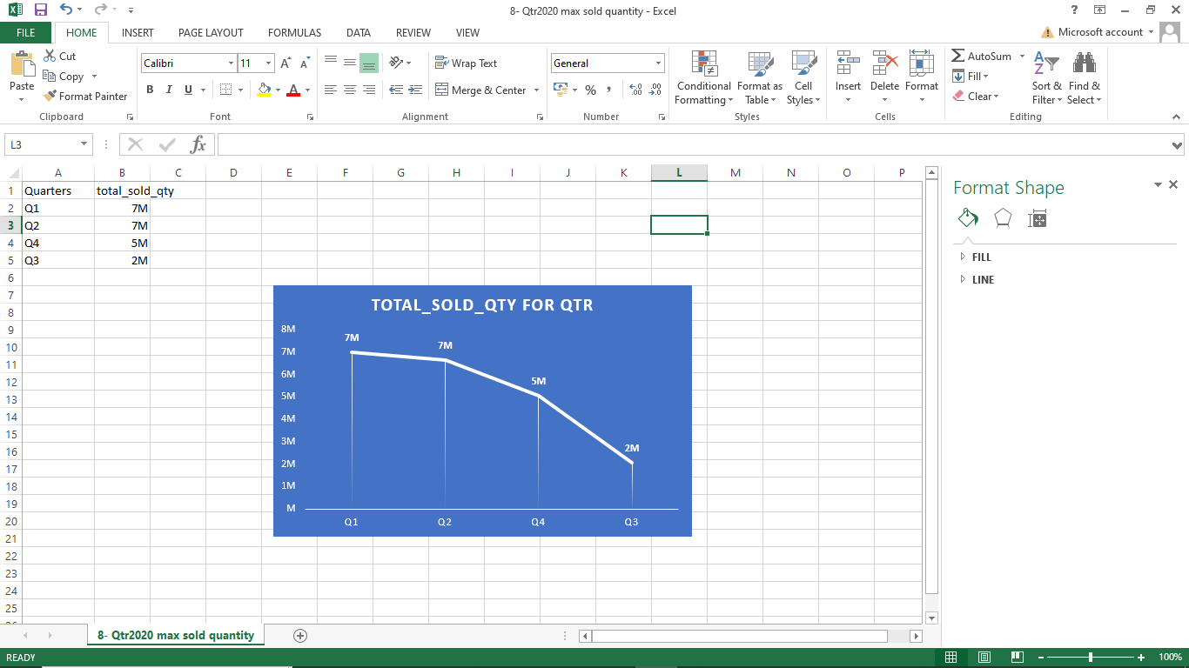
Visuals - 8
Insights
Q1 has the highest total sold quantity with $7,0056,19 units
Here, Q1 and Q2 are the high peforming quarters showing peak sales and Q3 being the low performing quarter among all.
These insight are valuable to apply appropriate marketing trends and experiment with seasonal performance to improve it.

Slide 21
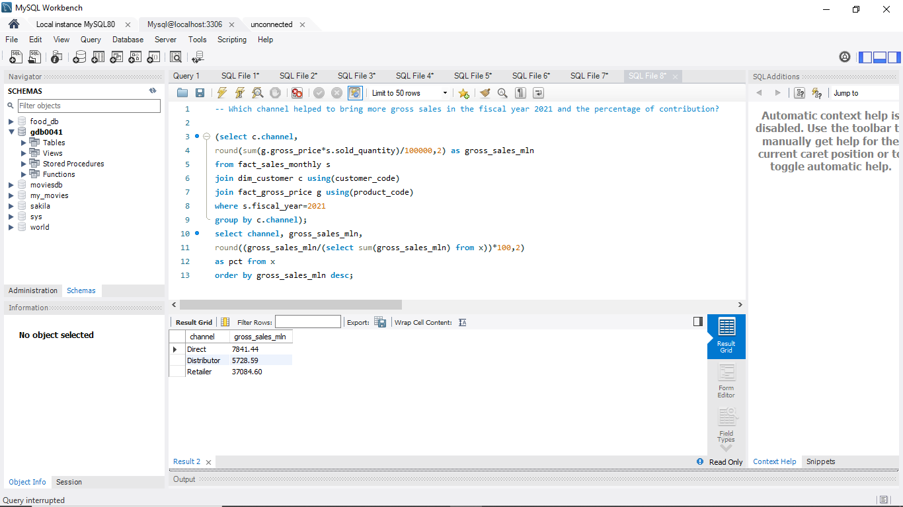
AD-HOC Request-9
Which channel helped to bring more gross sales in the fiscal year 2021 and the percentage of contribution?

Slide 22
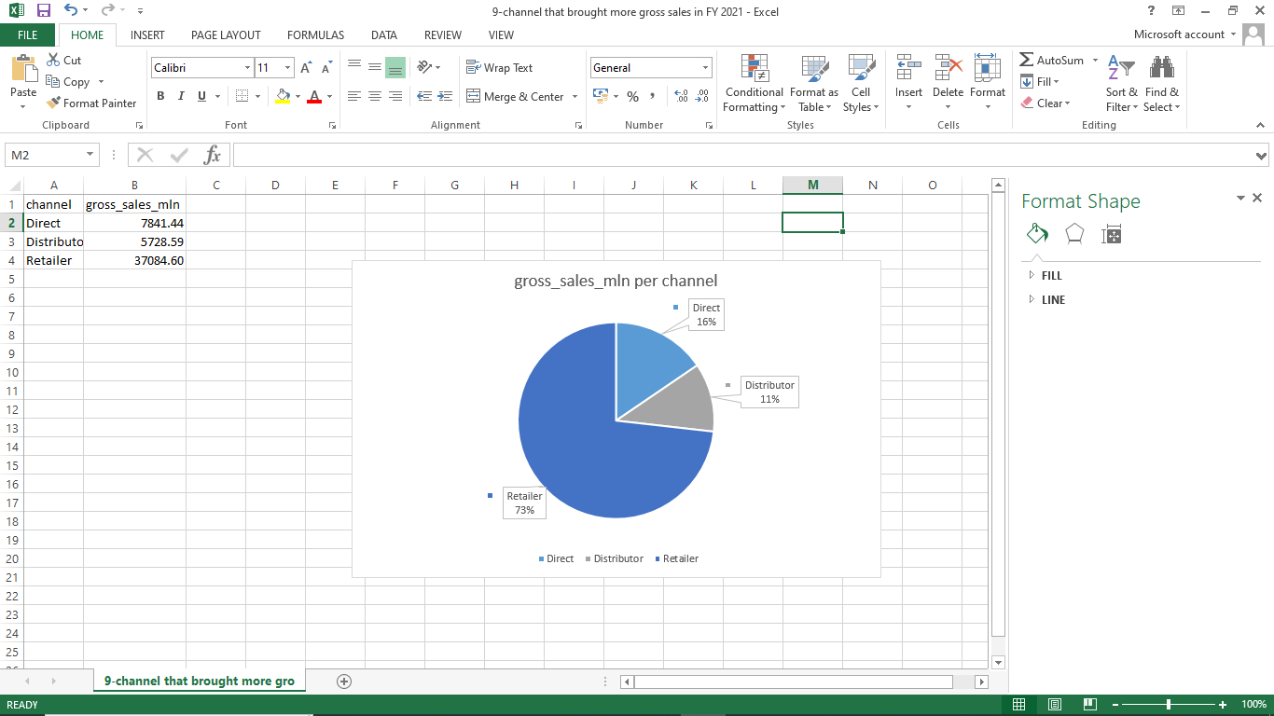
Visuals -9
Insights
Atliq Hardware operates through 3 channels, with Retailer generating the highest gross sales at 73% of the total contribution.
The Distributor channel accounts for the lowest gross sales at 11%.
The Direct channel contributes 16% to the overall sales.
These findings indicate that various growth strategies should be explored for the Direct and Distributor channels.

Slide 23
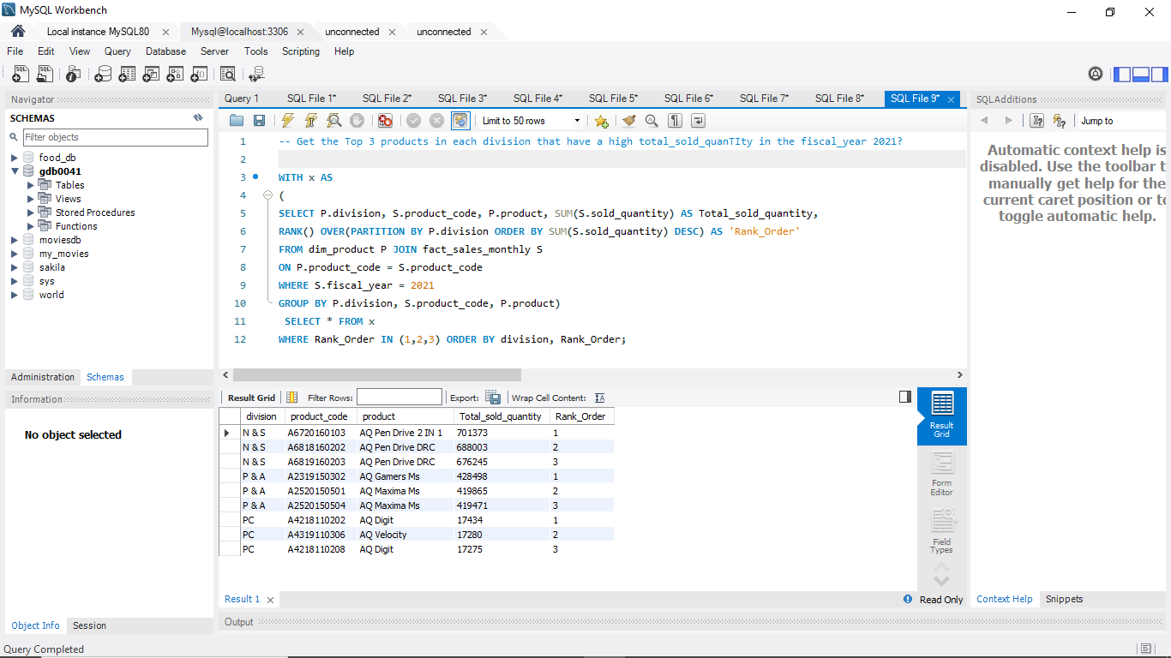
AD-HOC Request-10
Get the Top 3 products in each division that have a high total_sold_quanTIty in the fiscal_year 2021?

Slide 24
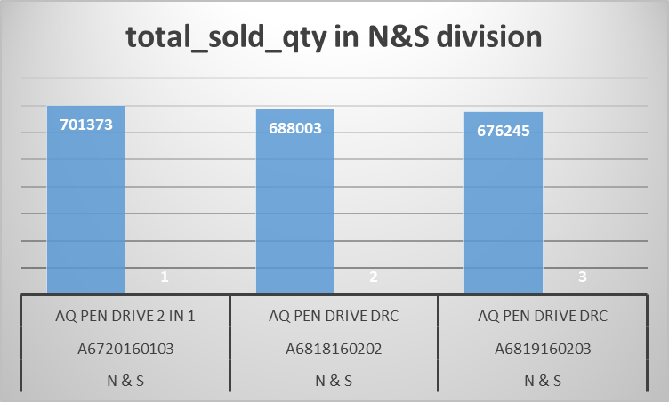
Visuals -10
Insights
Atliq Hardware has three divisions and N&S division performs excepetionally well among others.
In which AQ PEN DRIVE 2 IN 1 has the highest total sold quantity and ranks first with 701373 units.
Efficient store quantity is required for this segment as pen drives are sold in high quantity

Slide 25
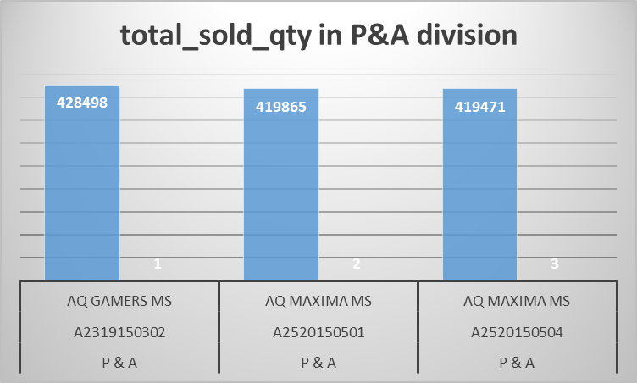
Visuals -10
Insights
AQ GAMERS MS has the highest total sold quantity and ranks first with 428498 units IN P&A division.
This segment focuses on gaming products.
AQ MAXIMA MS is variant of top performing product AQ GAMERS Ms.
Efficient storage is required to fulfill customer needs and promoting gaming products can boost performance of this segment.

Slide 26
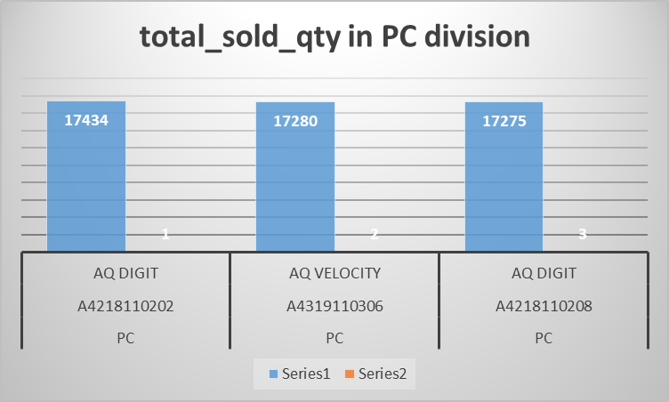
Visuals -10
Insights
The best selling product in PC divisions is AQ DIGIT .
This segment focuses on PC related products and provide customers with invaluable items.
Marketing and branding needs to be boosted to gain more profits and increase revenue.

Slide 27
Thank you

